Slide 1

IAS Order & Dray Management Estimation

Slide 2
Project Requirement/Scope
Scope of Work:
IAS has a requirement for developing a portal for Dray Management by IAS representative using the csv files that are uploaded by them every week. The scope also includes sending emails to Dray Provider and Freight Forwarder.
One shared platform for all IAS Member.
Option to load dock receipt by IAS Member.
View corresponding dock receipt on choosing file #.
Every week the members upload their shipments and the different details.
Members can send emails with attachments to trucker and forwarders.
Client use 2 truckers and 2 forwarders.

Slide 3
Assumptions and Dependencies
The scope of work is based on the CSV Data structure currently provided by IAS, any changes to the data structure would be handled through change management process subject to feasibility. This may result in changes in effort, cost and schedule.
Matching Customer and IAS Representative ID’s will be provided and updated on CSV Data instead of names.
Excelencia will create Super admin and sample IAS accounts during development.
Estimation is based on the attached excel sheet

Slide 4

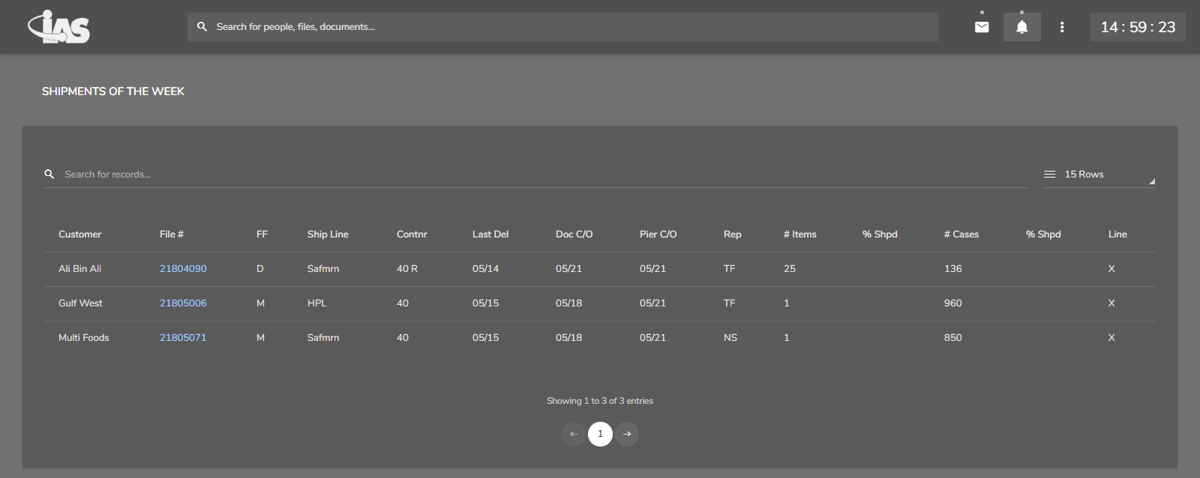
Screen Prototypes
1. IAS Member Login
2. IAS Member Shipment List

Slide 5
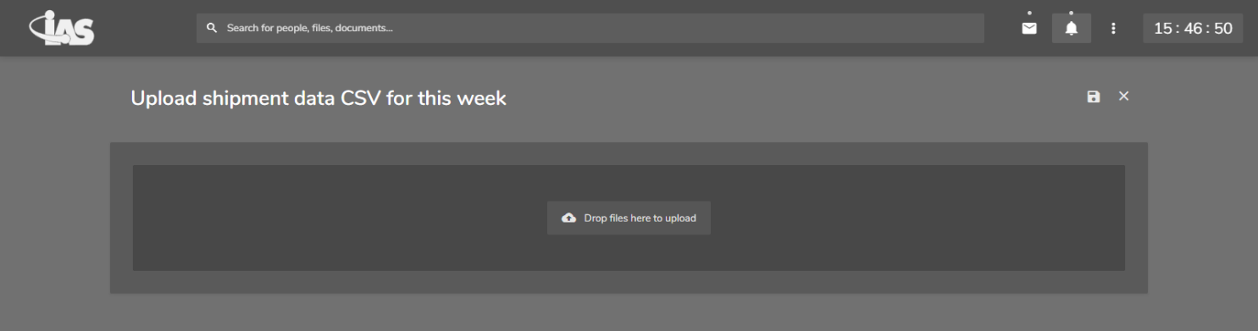
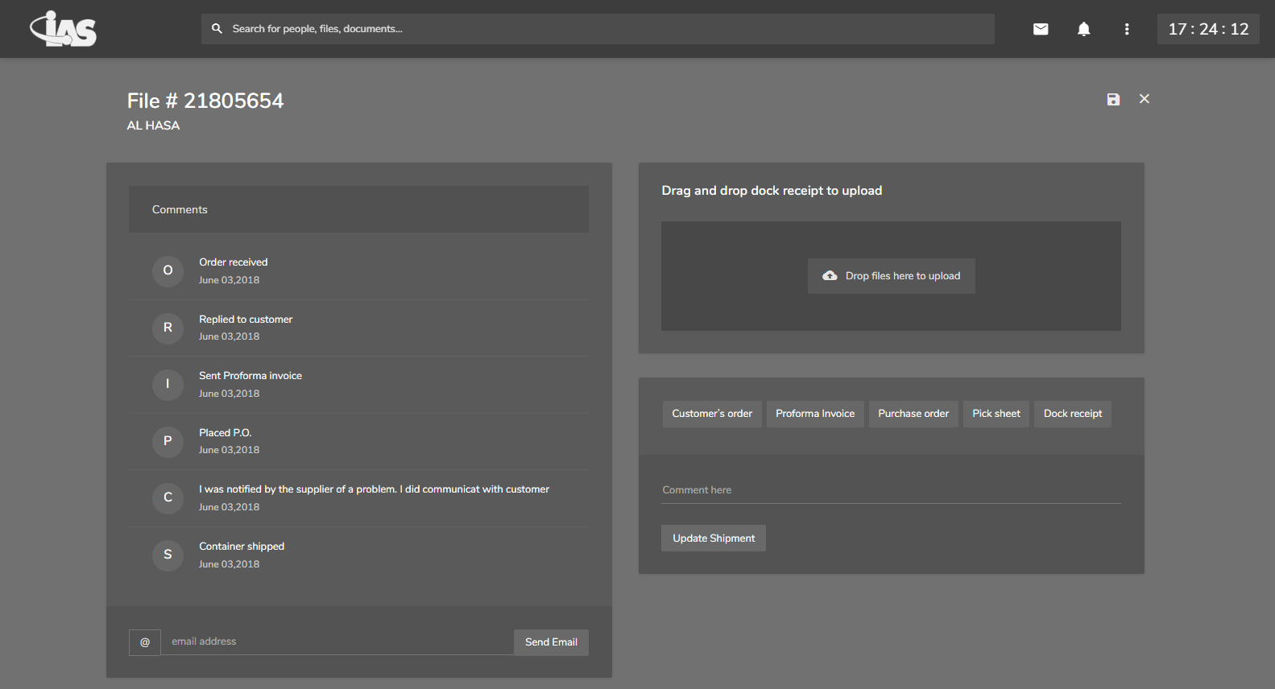
3. Uploading shipment CSV
4. Updating order details and mailing

Slide 6
Timeline & Cost
Approximately 30 – 40 Man days
Cost would be $6561
Payment Terms
Advance 25%
On Development Completion – 50%
After UAT – 25%

